Slide 1
Knx Interworking

Slide 2
Outline
Introduction
Definition
Topology
Communication
Knx Telegram
Datapoint Types
Structure
Datapoint Types Classes
Samples

Slide 3
Introduction
multi-vendor interworking : products of different manufacturers
cross-discipline interworking : products of different application fields
standardization of the protocol
rules for the useful data inside telegrams

Slide 4
Introduction Cont.
European Installation Bus Association (EIBA)
formats for common functions
switching
dimming
blinds control
integer and float values
Percentage
date/time
HVAC modes
EIB Interworking Standards (EIS)

Slide 5
Definition
Knx interworking : “The situation where products sending and receiving messages can properly understand signals and react on them without additional equipment” by knx.org
Advantages
choose between products of a large number of KNX manufacturers
single planning and configuration tool like ETS
worldwide uniform training scheme
facilitate the development of gateways between KNX and other systems (like DALI and BACnet)
…

Slide 6
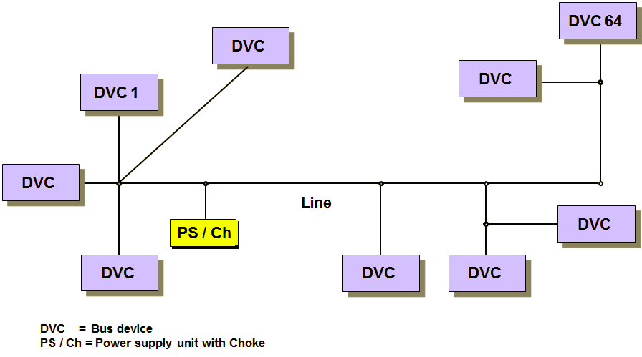
Topology (line)
exchange information by means of telegrams
maximum of 64 bus devices
requires an appropriate power supply
The actual number of devices is dependent on the power supply selected and the power input of the individual devices

Slide 7
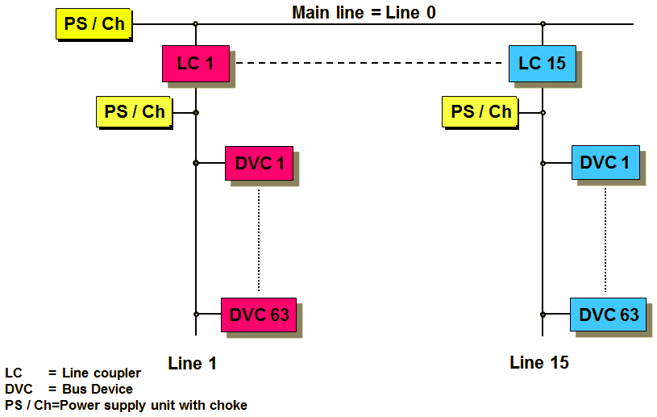
Topology (area)
up to 15 lines can be connected to a main line via a line coupler
possible to have up to 64 bus devices on the main line
Each line, including the main line, must have its own power supply unit

Slide 8
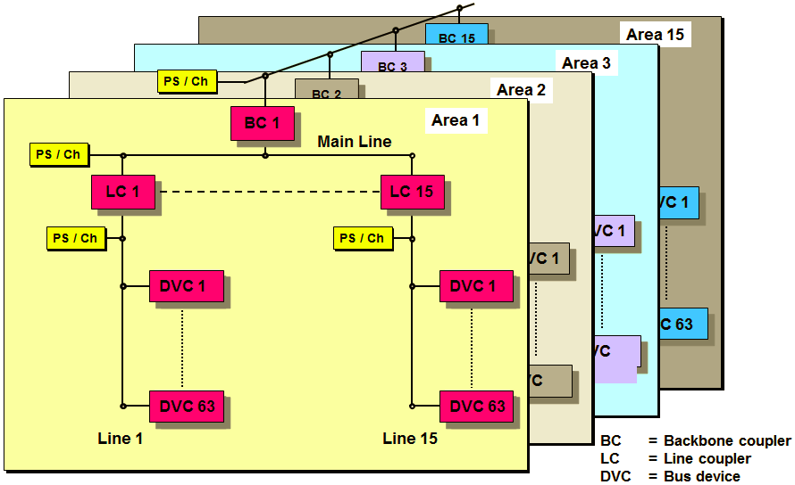
Topology (several areas)
maximum of 15 functional areas, more than 58,000 bus devices can be connected to the bus system

Slide 9
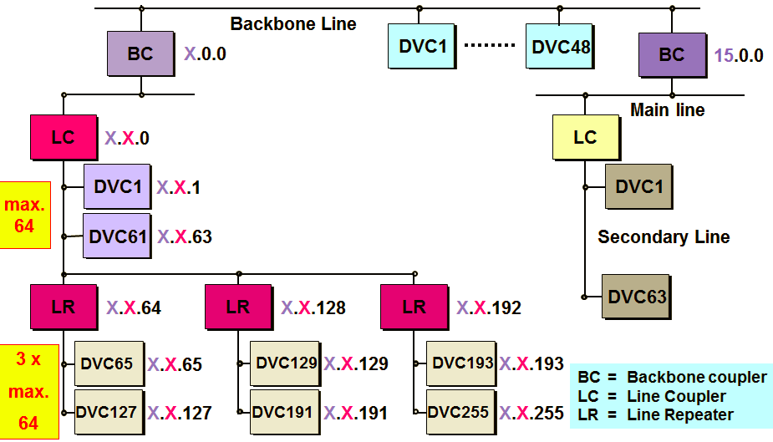
Topology (maximum)

Slide 10
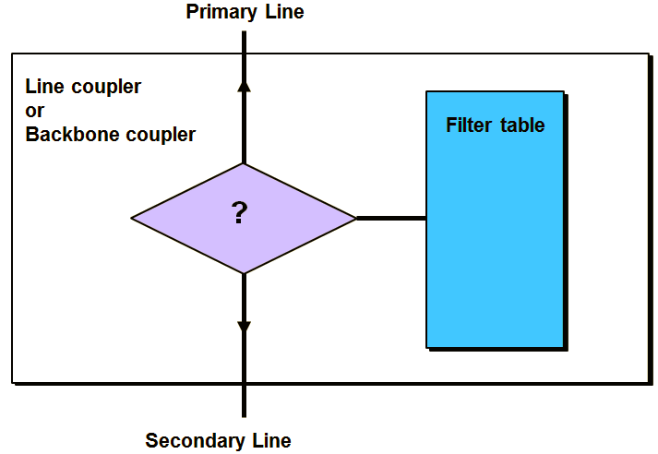
Topology (coupling unit)
coupling unit is provided with a filter table
received group telegrams are routed if they are listed in the filter table
each line works independently
line repeater passes on all telegrams; it has no filter table

Slide 11
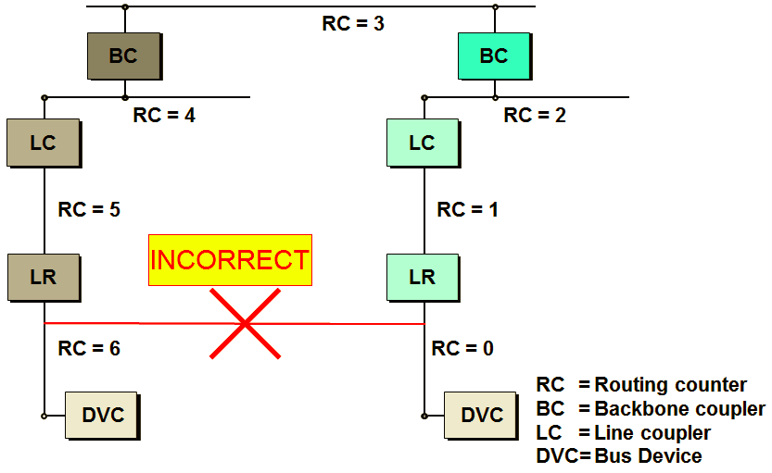
Topology (routing counter)
initial count value is 6
Each coupler decrements the routing counter and passes on the telegram as long as the value is not 0

Slide 12
Topology (group objects)
group address
Actuators can listen to several group addresses
Sensors can only send one group address per telegram
group objects are memory locations in bus devices
several group addresses can be assigned to one group object but only one is the sending group address

Slide 13
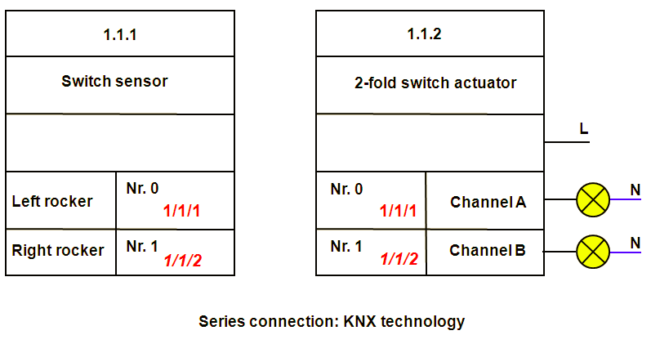
Topology (group objects)
If the upper left rocker is pressed for example, the two-fold switch sensor writes a “1” to its group object with the number 0. As the communication and transmit flag are set for this object, this device will send a telegram on the bus with the information “Group address 1/1/1, write value, 1”.
All the bus devices throughout the KNX installation that also have the group address 1/1/1 will then write “1” in their own group object.
In our example, the “1” is written in group object no. 0 of the actuator.
The application software of the actuator establishes that the value in this group object has changed and executes the switching process.

Slide 14

Topology (group object flags)
“master switch” for communication
if this flag is not set, the object cannot send or receive telegrams
It is set for all objects by default
If this object is linked to a group, an acknowledgement is sent even though the communication flag has been deleted

Slide 15

Topology (group object flags)
enables the object value to be read
response telegram is only sent after a read telegram if the read flag of the object has been set
set by default for status objects

Slide 16

Topology (group object flags)
enables the object status to be modified via the bus on the basis of a telegram
set by default for all switch objects, value objects (actuator) as well as all push button objects

Slide 17
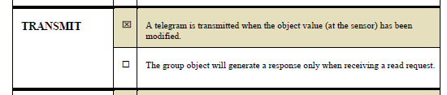
Topology (group object flags)
enables the group object to send telegrams
sending of telegrams can be triggered e.g. by a push button action, a variation in the temperature or a change in the object status
set for sensors by default

Slide 18
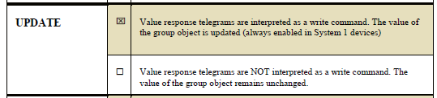
Topology (group object flags)
If the update flag is set, a response telegram of a read procedure is interpreted as a write telegram

Slide 19
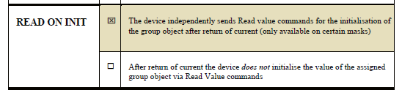
Topology (group object flags)
If the Read on Init flag is set, the bus device will independently read the value of its sending group address at initialisation

Slide 20
Communication
Connection-oriented Communication
point-to-point [P2P] connection
highly secure, but is not very bandwidth effective
the Transport Layer as well as the Link Layer will generate messages confirming reception of data
rejected telegrams are repeated up to three times
Ex. talking to one single person and checking after each question, whether he/she understood the question
In KNX : Downloading group addresses, parameters and/or application program from the PC (= ETS) into the KNX device

Slide 21
Communication
Connectionless Communication
the address must be sent together with the useful data after each data request
no confirmation of the data received
the device sending the information does not guarantee the correct order of the transmitted data blocks
one single message it is possible to reach all devices included in the installation
only one common acknowledgement of receipt is received

Slide 22
Communication
Connectionless Communication Cont.
not be ensured that all devices have correctly received the sent message
Ex. o talking to a group of persons and continuing with the next question if at least one person confirms that he/she understood the message
In KNX :
Normal operating mode of the KNX (telegrams with group addresses, Multicast, one to many communication)
Broadcast (one to all communication)

Slide 23
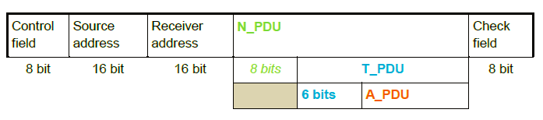
Knx Telegram

Slide 24
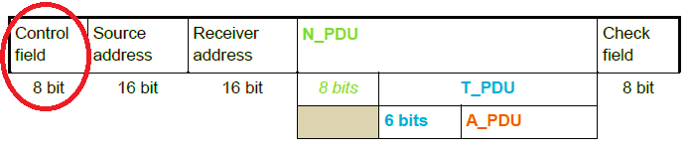

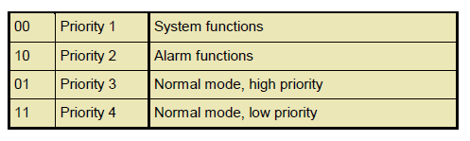
Knx Telegram
D5 : repeated telegram = 0, not = 1

Slide 25
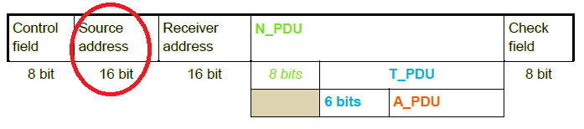
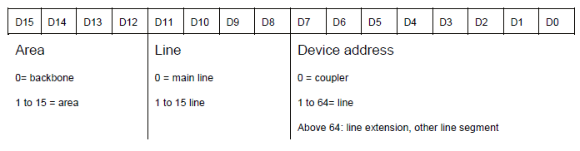
Knx Telegram

Slide 26
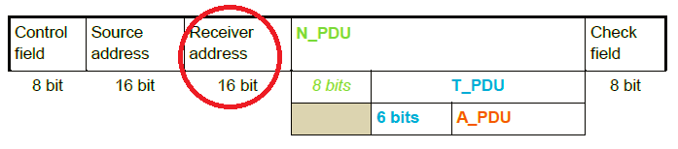
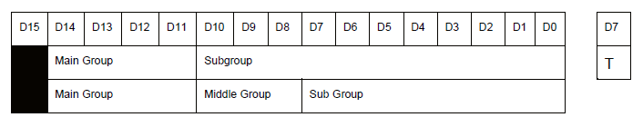
Knx Telegram
N_PDU last bit => D7 : group = 1, individual = 0

Slide 27
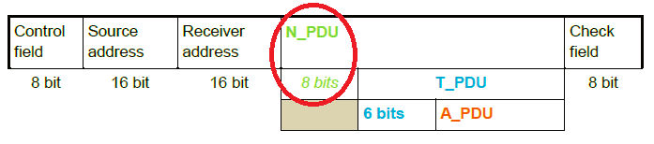
Knx Telegram
First bit : group = 1, individual = 0
Following 3 bits : the value of the routing counter, which will play a role in the routing of the telegram across line and backbone couplers
Following 4 bits : the length of the actual useful information in the telegram(depending on datapoint type)

Slide 28
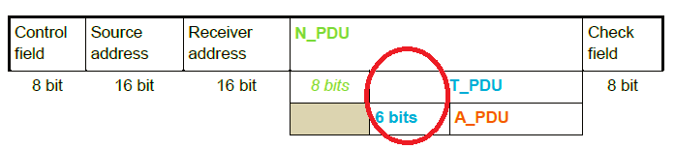
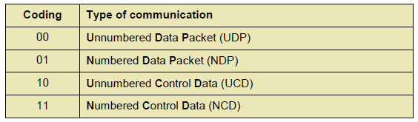
Knx Telegram
First two bits :
Following 4 bits : the sequence number(the communication type numbered)

Slide 29
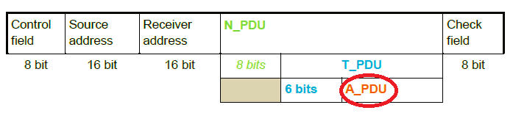
Knx Telegram
First two bits :
00 = a transport layer point to point connection is opened from the indicated sender to the indicated receiver
01 = an existing transport layer point to point connection between the indicated sender and the indicated receiver is terminated/broken down

Slide 30
Knx Telegram
First two bits :
10 = the transport layer of the indicated sender positively confirms to the indicated receiver reception of a previously received telegram.
11 = the transport layer of the indicated sender negatively confirms to the indicated receiver reception of a previously received telegram.

Slide 31

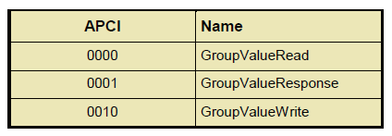
Knx Telegram
First four bits : APCI

Slide 32
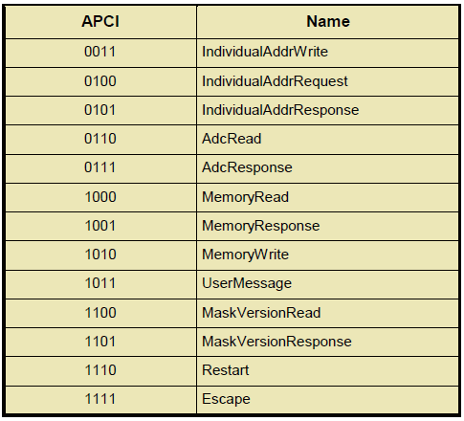
Knx Telegram

Slide 33
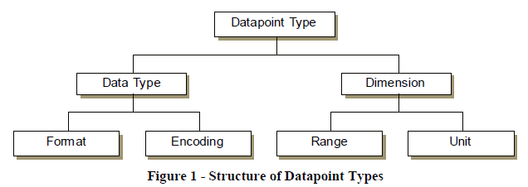
Datapoint Types
Structure

Slide 34
Datapoint Types
Classes
Simple Types : boolean values, pure numerical values
Enumerated Types : limited number of values, no precise hierarchical order
Structured Types : several parts which are combined in a datapoint
“Multi-state” Types : encodable values follow a hierarchical sequence and all encodable values are meaningful (0-255)
Status Types : report its operating mode to other devices, to be switched to a specific operating mode

Slide 35
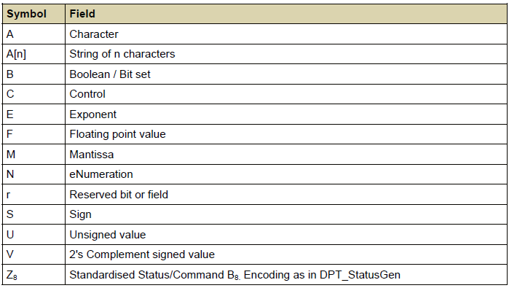
Datapoint Types
Formats

Slide 36
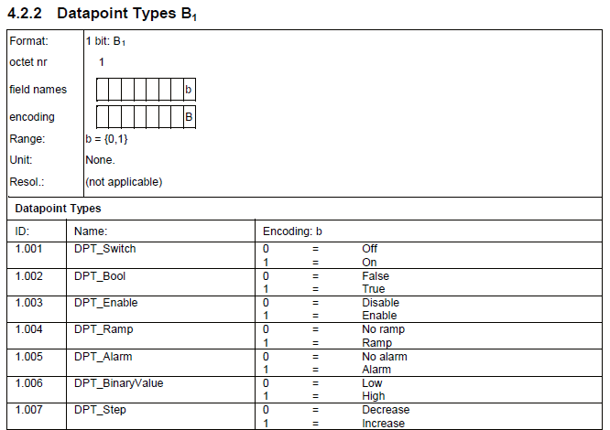
Datapoint Types

Slide 37
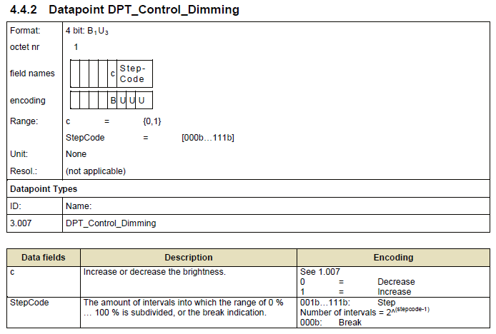
Datapoint Types

Slide 38
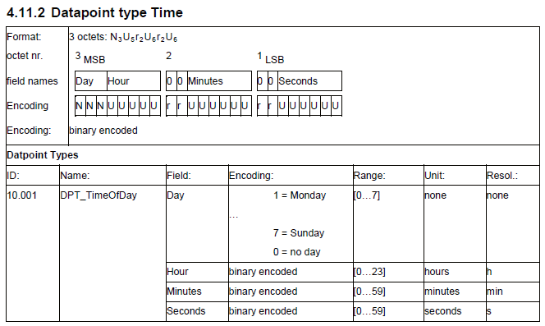
Datapoint Types

Slide 39
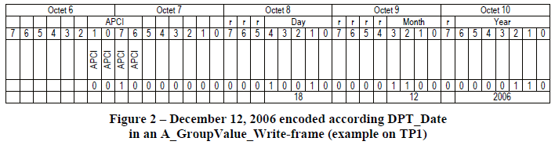
Datapoint Types

Slide 40
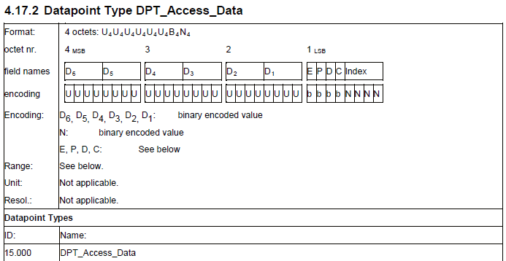
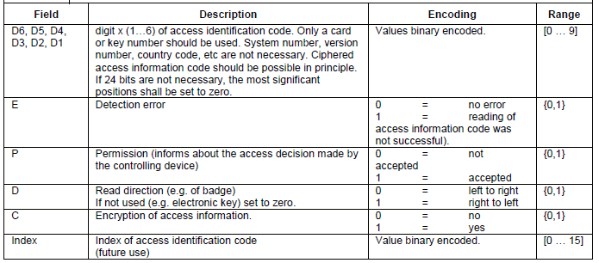
Datapoint Types

Slide 41
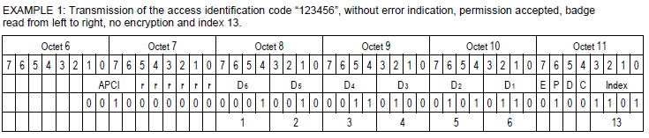
Datapoint Types

Slide 42
Thanks

